Slide 1




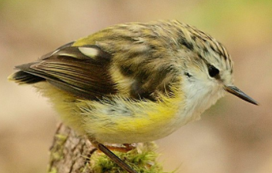
Welcome to the NCBI Datasets workshop!
Cold Spring Harbor Labs Genome Informatics 2021
November 2, 2021
START HERE
https://bit.ly/cshl2021

Slide 2
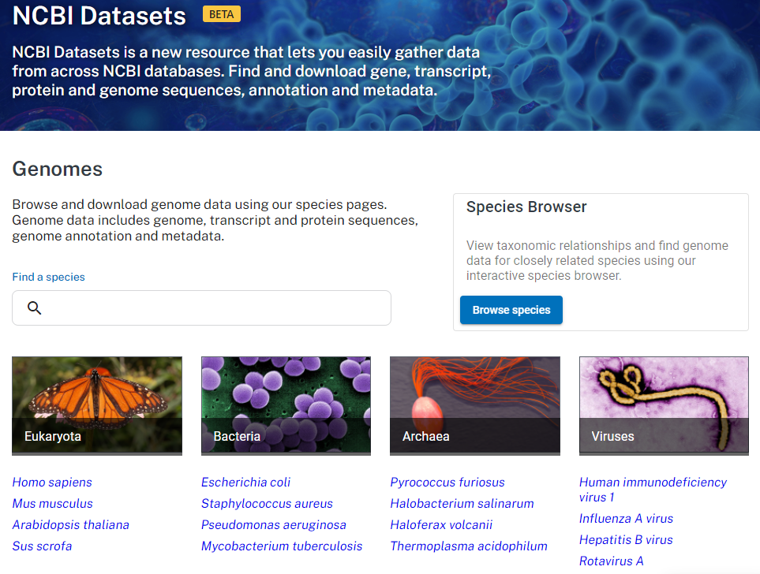
What is NCBI Datasets?
New resource that makes it easier for users to find and download NCBI sequence data
We’re achieving this by creating better web and programmatic interfaces for gathering NCBI sequence data

Slide 3
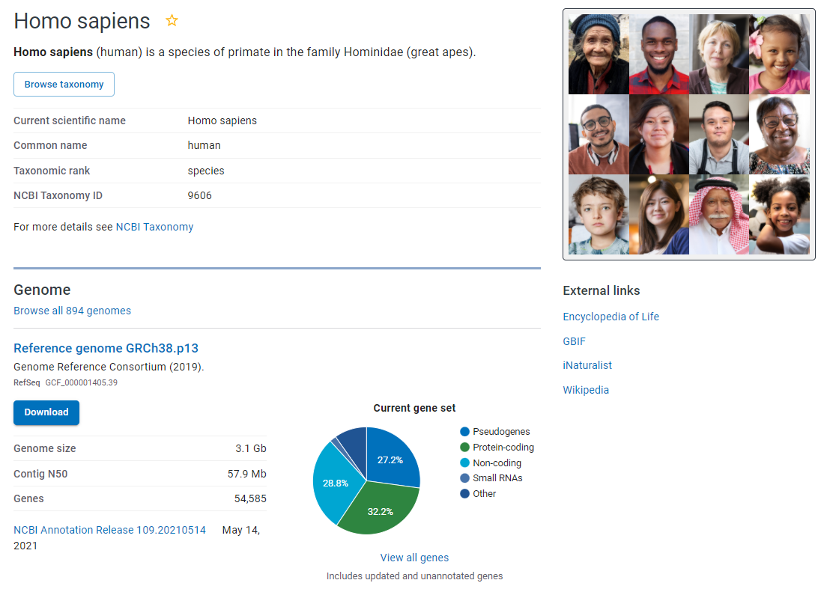
What data can you get from Datasets?
Datasets data packages include sequence, annotation and metadata for
Genomes
Genes
Orthologs
SARS-CoV-2 genomes
www.ncbi.nlm.nih.gov/data-hub/taxonomy/9606

Slide 4
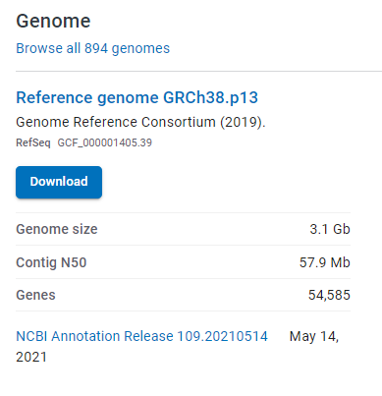
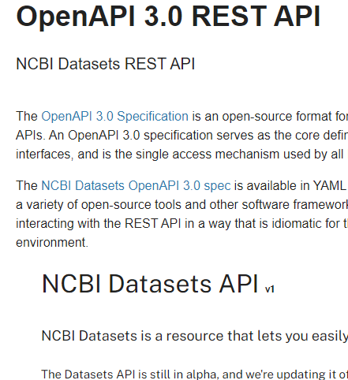
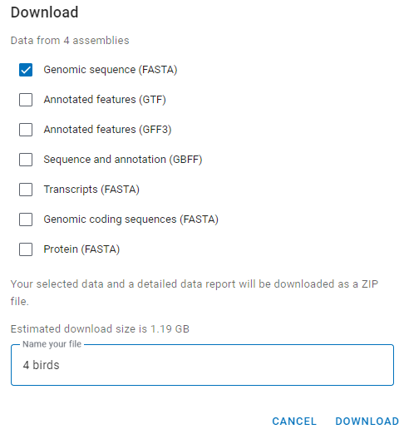
How can you access the data packages?
Web interface
Command line tools
Client libraries
> datasets download genome taxon human
Examples
datasets download genome accession GCF_000001405.39
datasets download genome taxon "bos taurus"
datasets download genome taxon human
datasets download genome accession PRJNA289059

Slide 5
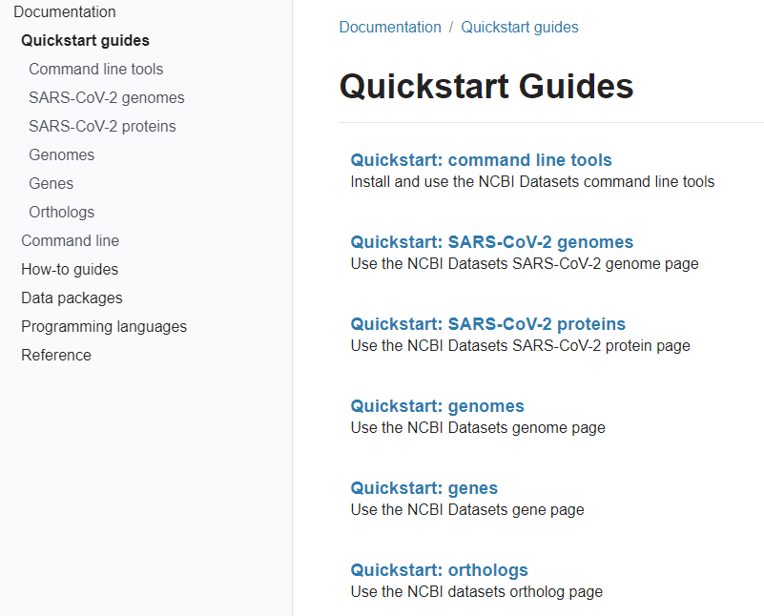
Explore examples in our documentation
Quick starts and How-to guides
Command line reference
Data schemas
Data package descriptions
OpenAPI docs
www.ncbi.nlm.nih.gov/datasets/docs/

